Slide 1

EECS 370 - Lecture 7
Linking
Live Poll + Q&A: slido.com #eecs370
Poll and Q&A Link

Slide 2

Announcements
P1
Project 1a due tonight
Project 1 s + m due Tuesday Thu 1/26
HW 2
Posted on website, due Mon 2/6 at 8 pm
Get exam conflicts and SSD accommodations sent to us by tomorrow
Forms listed on the website

Slide 3
Instruction Set Architecture (ISA) Design Lectures
Lecture 2: ISA - storage types, binary and addressing modes
Lecture 3 : LC2K
Lecture 4 : ARM
Lecture 5 : Converting C to assembly – basic blocks
Lecture 6 : Converting C to assembly – functions
Lecture 7 : Translation software; libraries, memory layout

Slide 4
Review - Saving / Restoring Registers
Higher level languages (like C/C++) provide many abstractions that don't exist at the assembly level
E.g. in C, each function has its own local variables
Even if different function have local variables with the same name, they are independent and guaranteed not to interfere with each other!
Still prints "1"… these don't interfere
void foo(){
int a=1;
bar();
printf(a);
}
void bar(){
int a=2;
return;
}

Slide 5
What about registers?
But in assembly, all functions share a small set (e.g. 32) of registers
Called functions will overwrite registers needed by calling functions
"Someone" needs to save/restore values when a function is called to ensure this doesn't happen
foo() overwrites X0 if we don't do something!!
main: movz X0, #1
bl foo
bl printf
foo: movz X0, #2
br X30

Slide 6
Review
a->r1, b->r2, etc.
Original C Code
Additions for Caller-save
Additions for Callee-save
void foo(){
int a,b,c,d;
a = 5; b = 6;
c = a+1; d=c-1;
bar();
d = a+d;
return();
}
void foo(){
int a,b,c,d;
a = 5; b = 6;
c = a+1; d=c-1;
save r1 to stack save r4 to stack
bar();
restore r1
restore r4
d = a+d;
return();
}
void foo(){
int a,b,c,d;
save r1
save r2
save r3
save r4
a = 5; b = 6;
c = a+1; d=c-1;
bar();
d = a+d;
restore r1
restore r2
restore r3
restore r4
return();
}
No need to save r2/r3. Why?
Assume bar() will overwrite all registers
bar() will save a,b, but now foo() must save main's variables

Slide 7
“caller-save” vs. “callee-save”
Caller-save
What if bar() doesn't use r1/r4?
No harm done, but wasted work
Callee-save
What if main() doesn't use r1-r4?
No harm done, but wasted work
void foo(){
int a,b,c,d;
save r1
save r2
save r3
save r4
a = 5; b = 6;
c = a+1; d=c-1;
bar();
d = a+d;
restore r1
restore r2
restore r3
restore r4
return();
}
void foo(){
int a,b,c,d;
a = 5; b = 6;
c = a+1; d=c-1;
save r1 to stack save r4 to stack
bar();
restore r1
restore r4
d = a+d;
return();
}

Slide 8
Another helpful visual
CALLER-CALLEE
foo() {
. . .
bar ();
. . .
}
bar() {
. . .
. . .
. . .
}
Callee save
Caller save
Caller restore
Callee restore
Notes:
8

Slide 9
Saving/Restoring Optimizations
CALLER-CALLEE
Where can we avoid loads/stores?
Caller-saved
Only needs saving if value is “live” across function call
Live = contains a useful value: Assign value before function call, use that value after the function call
In a leaf function (a function that calls no other function), caller saves can be used without saving/restoring
void foo(){
int a,b,c,d;
a = 5; b = 6;
c = a+1; d=c-1;
bar();
d = a+d;
return();
}
a, d are live
b, c are NOT live
Notes:
9

Slide 10
Saving/Restoring Optimizations
CALLER-CALLEE
Where can we avoid loads/stores?
Callee-saved
Only needs saving at beginning of function and restoring at end of function
Only save/restore it if function overwrites the register
void foo(){
int a,b,c,d;
a = 5; b = 6;
c = a+1; d=c-1;
bar();
d = a+d;
return();
}
Only use r1-r4
No need to save other registers
Notes:
10

Slide 11
Caller versus Callee
Which is better??
Let's look at some examples…
Simplifying assumptions:
A function can be invoked by many different call sites in different functions.
Assume no inter-procedural analysis (hard problem)
A function has no knowledge about which registers are used in either its caller or callee
Assume main() is not invoked by another function
Implication
Any register allocation optimization is done using function local information

Slide 12
Caller-saved vs. callee saved – Multiple function case
void main(){
int a,b,c,d;
c = 5; d = 6;
a = 2; b = 3;
foo();
d = a+b+c+d;
}
void foo(){
int e,f;
e = 2; f = 3;
bar();
e = e + f;
}
void bar(){
int g,h,i,j;
g = 0; h = 1;
i = 2; j = 3;
final();
j = g+h+i;
}
void final(){
int y,z;
y = 2; z = 3;
z = y+z;
}
Note: assume main does not have to save any callee registers

Slide 13
Caller-saved vs. callee saved – Multiple function case
Questions:
How many registers need to be saved/restored if we use a caller-save convention?
How many registers need to be saved/restored if we use a callee-save convention?
How many registers need to be saved/restored if we use a mix of caller-save and callee-save?

Slide 14
Question 1: Caller-save
Poll: How many ld/st pairs are needed?
void main(){
int a,b,c,d;
c = 5; d = 6;
a = 2; b = 3;
[4 STUR]
foo();
[4 LDUR]
d = a+b+c+d;
}
void foo(){
int e,f;
e = 2; f = 3;
[2 STUR]
bar();
[2 LDUR]
e = e + f;
}
void bar(){
int g,h,i,j;
g = 0; h = 1;
i = 2; j = 3;
[3 STUR]
final();
[3 LDUR]
j = g+h+i;
}
void final(){
int y,z;
y = 2; z = 3;
z = y+z;
}
Total: 9 STUR / 9 LDUR
Live Poll + Q&A: slido.com #eecs370

Slide 15
Question 2: Callee-save
Poll: How many ld/st pairs are needed?
void main(){
int a,b,c,d;
c = 5; d = 6;
a = 2; b = 3;
foo();
d = a+b+c+d;
}
void foo(){
[2 STUR]
int e,f;
e = 2; f = 3;
bar();
e = e + f;
[2 LDUR]
}
void bar(){
[4 STUR]
int g,h,i,j;
g = 0; h = 1;
i = 2; j = 3;
final();
j = g+h+i;
[4 LDUR]
}
void final(){
[2 STUR]
int y,z;
y = 2; z = 3;
z = y+z;
[2 LDUR]
}
Total: 8 STUR / 8 LDUR
Live Poll + Q&A: slido.com #eecs370

Slide 16
Is one better?
Caller-save works best when we don't have many live values across function call
Callee-save works best when we don't use many registers overall
We probably see functions of both kinds across an entire program
Solution:
Use both!
E.g. if we have 6 registers, use some (say r0-r2) as caller-save and others (say r3-r5) as callee-save
Now each function can optimize for each situation to reduce saving/restoring

Slide 17
Question 3: Mixed 3 caller / 3 callee
Poll: What's the optimal number of caller/callee registers for final?
For main, ideally put all variables in callee-save registers
But we only 3 are available
One variable needs to go in caller-saved register
void main(){
int a,b,c,d;
c = 5; d = 6;
a = 2; b = 3;
[1 STUR]
foo();
[1 LDUR]
d = a+b+c+d;
}
void foo(){
[2 STUR]
int e,f;
e = 2; f = 3;
bar();
e = e + f;
[2 LDUR]
}
void bar(){
[3 STUR]
int g,h,i,j;
g = 0; h = 1;
i = 2; j = 3;
final();
j = g+h+i;
[3 LDUR]
}
void final(){
int y,z;
y = 2; z = 3;
z = y+z;
}
2 caller r
1 caller r
3 callee r
2 callee r
(2 caller would be equivalent)
1 caller r
3 callee r
Total: 6 STUR / 6 LDUR
Live Poll + Q&A: slido.com #eecs370

Slide 18
LEGv8 ABI- Application Binary Interface
The ABI is an agreement about how to use the various registers
Not enforced by hardware, just a convention by programmers / compilers
If you won't your code to work with other functions / libraries, follow these
Some register conventions in ARMv8
X30 is the link register – used to hold return address
X28 is stack pointer – holds address of top of stack
X19-X27 are callee-saved – function must save live values before call
X0-15 are caller-saved – function must save these before writing to them
X0-X7 used for arguments (memory used if more space is needed)
X0 used for return value

Slide 19
Caller/Callee
Still not clicking?
Don't worry, this is a tricky concept for students to get
Check out supplemental video
https://www.youtube.com/watch?v=SMH5uL3HiiU
Come to office hours to go over examples

Slide 20
Today we’ll finish up software
Introduce linkers and loaders
Basic relationship of complier, assembler, linker and loader.
Object files
Symbol tables and relocation tables

Slide 21
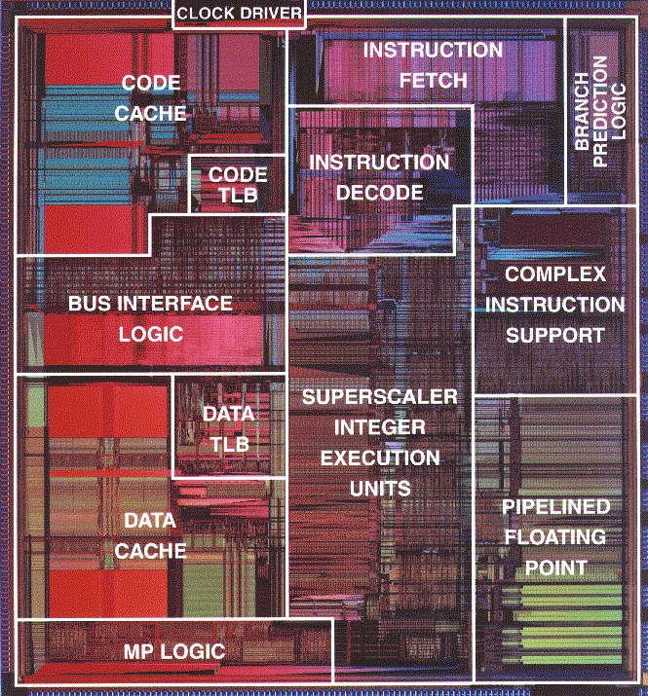
Source Code to Execution
In project 1a, our view is this:
Assembly
Assembler
Poll: Why do we write programs in multiple files?
Executable
Not very accurate… why?
Because in reality, we have multiple files
Live Poll + Q&A: slido.com #eecs370

Slide 22
Multi-file programs
In practice, programs are made from thousands or millions of lines of code
Use pre-existing libraries like stdlib
If we change one line, do we need to recompile the whole thing?
No! If we compile each file into a separate object file, then we only need to recompile that one file and link it to the other, unchanged object files

Slide 23
Source Code to Execution
What do object files look like?
C, C++, etc.
Assembly
Object File
Compiler
Assembler
Assembly
Assembly
Object File
Library
Library
Library
Linker
Loader
Executable
DLL

Slide 24
What do object files look like?
extern int Y;
int X;
void foo() {
Y *= 2;
}
extern int X;
extern void foo();
int Y;
void main() {
Y = X + 1;
foo();
}
"extern" means defined in another file
.main:
LDUR X1, [XZR, X]
ADDI X9, X1, #1
STUR X9, [XZR, Y]
BL foo
HALT
.foo:
LDUR X1, [XZR, Y]
LSL X9, X1, #1
STUR X9, [XZR, Y]
BR X30
Compile
Compile
Uh-oh!
Don't know address of X, Y, or foo!

Slide 25
Linking
NOTE: this will actually be in machine code, not assembly
What needs to go in this intermediate "object file"?
.main:
LDUR X1, [XZR, X]
ADDI X9, X1, #1
STUR X9, [XZR, Y]
BL foo
HALT
LDUR X1, [XZR, #40]
ADDI X9, X1, #1
STUR X9, [XZR, #36]
BL #2
HALT
LDUR X1, [XZR, #36]
LSL X9, X1, #1
STUR X9, [XZR, #36]
BR X30
// Addr #36 starts here
Assemble
???
LINK
.foo:
LDUR X1, [XZR, Y]
LSL X9, X1, #1
STUR X9, [XZR, Y]
BR X30
LINK
Assemble
???

Slide 26
Linking
.main:
LDUR X1, [XZR, X]
ADDI X9, X1, #1
STUR X9, [XZR, Y]
BL foo
HALT
LDUR X1, [XZR, #40]
ADDI X9, X1, #1
STUR X9, [XZR, #36]
BL #2
HALT
LDUR X1, [XZR, #36]
LSL X9, X1, #1
STUR X9, [XZR, #36]
BR X30
Assemble
???
LINK
We need:
the assembled machine code:
list of instructions that need to be updated once addresses are resolved
list of symbols to cross-ref

Slide 27
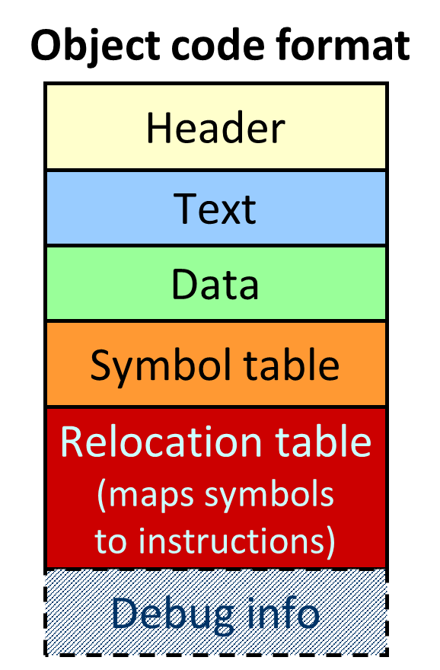
What do object files look like?
Since we can't make executable, we make an object file
Basically, includes the machine code that will go in the executable
Plus extra information on what we need to modify once we stitch all the other object files together
Looks like this ->
We won't discuss "Debug" much. Get's included when you compile with "-g" in gcc

Slide 28
Assembly → Object file - example
Header Name foo
Text size 0x0C //probably bigger
Data size 0x04 //probably bigger
Text Address Instruction
0 LDUR X1, [XZR, G]
4 ADDI X9, X1, #1 8 BL B
Data 0 X 3
Label Address
Symbol X 0
table B -
main 0 G -
Reloc Addr Instruction type Dependency
table 0 LDUR G
8 BL B
extern int G;
extern void B();
int X = 3;
main() {
Y = G + 1;
B();
}
LDUR X1, [XZR, G]
ADDI X9, X1, #1
BL B

Slide 29
Assembly → Object file - example
Header:
keeps track of size of each section
Header Name foo
Text size 0x0C //probably bigger
Data size 0x04 //probably bigger
Text Address Instruction
0 LDUR X1, [XZR, G]
4 ADDI X9, X1, #1 8 BL B
Data 0 X 3
Label Address
Symbol X 0
table B -
main 0 G -
Reloc Addr Instruction type Dependency
table 0 LDUR G
8 BL B
extern int G;
extern void B();
int X = 3;
main() {
Y = G + 1;
B();
}
LDUR X1, [XZR, G]
ADDI X9, X1, #1
BL B

Slide 30
Assembly → Object file - example
Header Name foo
Text size 0x0C //probably bigger
Data size 0x04 //probably bigger
Text Address Instruction
0 LDUR X1, [XZR, G]
4 ADDI X9, X1, #1 8 BL B
Data 0 X 3
Label Address
Symbol X 0
table B -
main 0 G -
Reloc Addr Instruction type Dependency
table 0 LDUR G
8 BL B
extern int G;
extern void B();
int X = 3;
main() {
Y = G + 1;
B();
}
Text:
machine code
LDUR X1, [XZR, G]
ADDI X9, X1, #1
BL B

Slide 31
Assembly → Object file - example
Simplifying Assumption for EECS370
All globals and static locals (initialized or not) go in the data segment
Header Name foo
Text size 0x0C //probably bigger
Data size 0x04 //probably bigger
Text Address Instruction
0 LDUR X1, [XZR, G]
4 ADDI X9, X1, #1 8 BL B
Data 0 X 3
Label Address
Symbol X 0
table B -
main 0 G -
Reloc Addr Instruction type Dependency
table 0 LDUR G
8 BL B
extern int G;
extern void B();
int X = 3;
main() {
Y = G + 1;
B();
}
Data:
initialized globals and static locals
LDUR X1, [XZR, G]
ADDI X9, X1, #1
BL B

Slide 32
Assembly → Object file - example
Header Name foo
Text size 0x0C //probably bigger
Data size 0x04 //probably bigger
Text Address Instruction
0 LDUR X1, [XZR, G]
4 ADDI X9, X1, #1 8 BL B
Data 0 X 3
Label Address
Symbol X 0
table B -
main 0 G -
Reloc Addr Instruction type Dependency
table 0 LDUR G
8 BL B
extern int G;
extern void B();
int X = 3;
main() {
Y = G + 1;
B();
}
Symbol table:
Lists all labels
visible outside this file
(i.e. function names and global variables)
LDUR X1, [XZR, G]
ADDI X9, X1, #1
BL B

Slide 33
Assembly → Object file - example
Header Name foo
Text size 0x0C //probably bigger
Data size 0x04 //probably bigger
Text Address Instruction
0 LDUR X1, [XZR, G]
4 ADDI X9, X1, #1 8 BL B
Data 0 X 3
Label Address
Symbol X 0
table B -
main 0 G -
Reloc Addr Instruction type Dependency
table 0 LDUR G
8 BL B
extern int G;
extern void B();
int X = 3;
main() {
Y = G + 1;
B();
}
LDUR X1, [XZR, G]
ADDI X9, X1, #1
BL B
Relocation Table:
list of instructions and data words that must be updated
if things are moved in memory

Slide 34
Class Problem 1
Poll: Which symbols will be put in the symbol table? (i.e. which "things" should be visible to all files?)
file1.c
extern void bar(int);
extern char c[];
int a;
int foo (int x) {
int b;
a = c[3] + 1;
bar(x);
b = 27;
}
file2.c
extern int a;
char c[100];
void bar (int y) {
char e[100];
a = y;
c[20] = e[7];
}
file 2 – symbol table
sym loc
c data
bar text
a -
file 1 – symbol table
sym loc a data
foo text
c -
bar -
Live Poll + Q&A: slido.com #eecs370

Slide 35
Class Problem 2
Poll: Which lines / instructions are in the relocation table? (i.e. which "things" need to be updated after linking?)
file1.c
extern void bar(int);
extern char c[];
int a;
int foo (int x) {
int b;
a = c[3] + 1;
bar(x);
b = 27;
}
file2.c
extern int a;
char c[100];
void bar (int y) {
char e[100];
a = y;
c[20] = e[7];
}
1
2
3
4
5
6
7
8
9
1
2
3
4
5
6
7
Note: in a real relocation table, the “line” would really be the address in “text” section of the instruction we need to update.
file 2 - relocation table
line type dep
5 stur a
6 stur c
file 1 - relocation table line type dep
6 ldur c
6 stur a
7 bl bar
Live Poll + Q&A: slido.com #eecs370

Slide 36
Linker
Stitches independently created object files into a single executable file (i.e., a.out)
Step 1: Take text segment from each .o file and put them together.
Step 2: Take data segment from each .o file, put them together, and concatenate this onto end of text segments.
What about libraries?
Libraries are just special object files.
You create new libraries by making lots of object files (for the components of the library) and combining them (see ar and ranlib on Unix machines).
Step 3: Resolve cross-file references to labels
Make sure there are no undefined labels

Slide 37
Linker - Continued
Determine the memory locations the code and data of each file will occupy
Each function could be assembled on its own
Thus, the relative placement of code/data is not known up to this point
Must relocate absolute references to reflect placement by the linker
PC-Relative Addressing (beq, bne): never relocate
Absolute Address (mov 27, #X): always relocate
External Reference (usually bl): always relocate
Data Reference (often movz/movk): always relocate
Executable file contains no relocation info or symbol table these just used by assembler/linker

Slide 38
Loader
Executable file is sitting on the disk
Puts the executable file code image into memory and asks the operating system to schedule it as a new process
Creates new address space for program large enough to hold text and data segments, along with a stack segment
Copies instructions and data from executable file into the new address space
Initializes registers (PC and SP most important)
Take operating systems class (EECS 482) to learn more!

Slide 39
Summary
Compiler converts a single source code file into a single assembly language file
Assembler handles directives (.fill), converts what it can to machine language, and creates a checklist for the linker (relocation table). This changes each .s file into a .o file
Assembler does 2 passes to resolve addresses, handling internal forward references
Linker combines several .o files and resolves absolute addresses
Linker enables separate compilation: Thus unchanged files, including libraries need not be recompiled.
Linker resolves remaining addresses.
Loader loads executable into memory and begins execution

Slide 40

Next Time
Floating Point Arithmetic
And… hardware time, baby!
Lingering questions / feedback? I'll include an anonymous form at the end of every lecture: https://bit.ly/3oXr4Ah
Live Poll + Q&A: slido.com #eecs370

Slide 41
Floating Point Arithmetic

Slide 42
Why floating point
Have to represent real numbers somehow
Rational numbers
Ok, but can be cumbersome to work with
Fixed point
Do everything in thousandths (or millionths, etc.)
Not always easy to pick the right units
Different scaling factors for different stages of computation
Scientific notation: this is good!
Exponential notation allows HUGE dynamic range
Constant (approximately) relative precision across the whole range

Slide 43
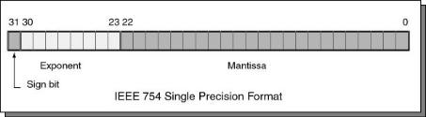
IEEE Floating point format (single precision)
Sign bit: (0 is positive, 1 is negative)
Significand: (also called the mantissa; stores the 23 most significant bits after the decimal point)
Exponent: used biased base 127 encoding
Add 127 to the value of the exponent to encode:
-127 → 00000000 1 → 10000000
-126 → 00000001 2 → 10000001
… …
0 → 01111111 128 → 11111111
How do you represent zero ? Special convention:
Exponent: -127 (all zeroes ), Significand 0 (all zeroes), Sign + or -
EECS 370: Introduction to Computer Organization
43

Slide 44
Floating Point Representation
10.625 ₁₀
1010.101 ₂
Step 1: convert from decimal to binary
1st bit after "binary" point represents 0.5 (i.e. 2⁻¹)
2nd bit represents 0.25 (i.e. 2⁻²)
etc.

Slide 45
Floating Point Representation
10.625 ₁₀
1010.101 ₂
1.010101 × 2 ³
Step 2: normalize number by shifting binary point until you get 1.XXX * 2^{Y}

Slide 46
Floating Point Representation
10.625 ₁₀
1010.101 ₂
1.010101 × 2 ³
+/-
Exponent (3)
Significand (1010101)
This must be a 1!
So don’t store it.
1 bit
8 bits
23 bits
Step 3: store relevant numbers in proper location (ignoring initial 1 of significand)

Slide 47
Floating Point Representation
10.625 ₁₀
1010.101 ₂
1.010101 × 2 ³
+/-
Exponent (3)
Significand (1010101)
This must be a 1!
So don’t store it.
1 bit
8 bits
23 bits
10.625₁₀ = 0 10000010 01010100000000000000000

